Slide 1
Green Composites
A Review on Green Composites and a Real Life Application PLA/PALF Composite

Slide 2
Content
Development and Characterization of PLA-based Green Composites
Application of green composites
Constituents
Types of composites
Green fibers and PLA
PLA green composites and its mechanical properties
Pineapple Leaf Fiber Reinforced Poly lactic Acid Green Composites
Experimental
Results & Discussion
Conclusion
Discussion
Compare and contrast of research papers
Reflection on both papers
Mass production and marketability of green composites
Life Cycle Assessment on green composites
SWOT analysis of green composites
Green composites and the biobased economy

Slide 3
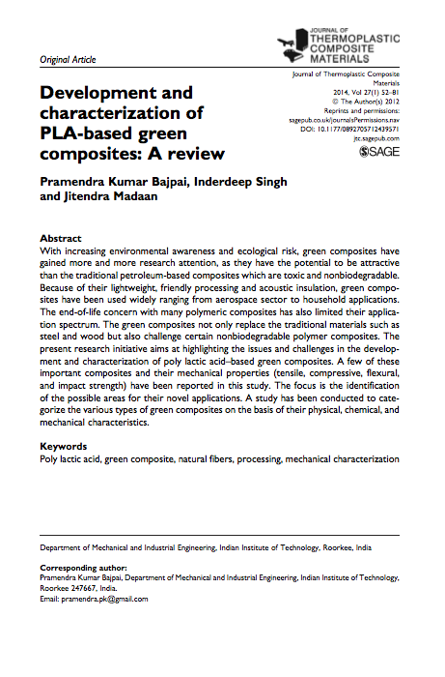
Research Paper I Development and Characterization of PLA-based Green Composites: A Review
Constituents of composites
Applications of green composites
Green fibers
Sustainable matrix biopolymer – Poly lactic acid (PLA).
PLA Green Composites
Mechanical properties
Differences in mechanical properties
Conclusion

Slide 4
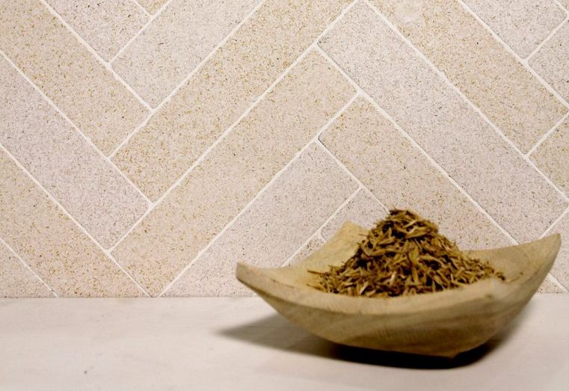
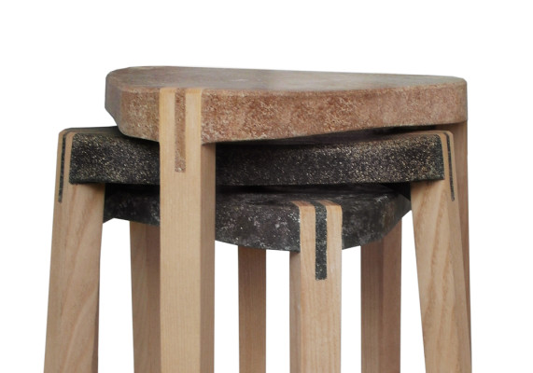
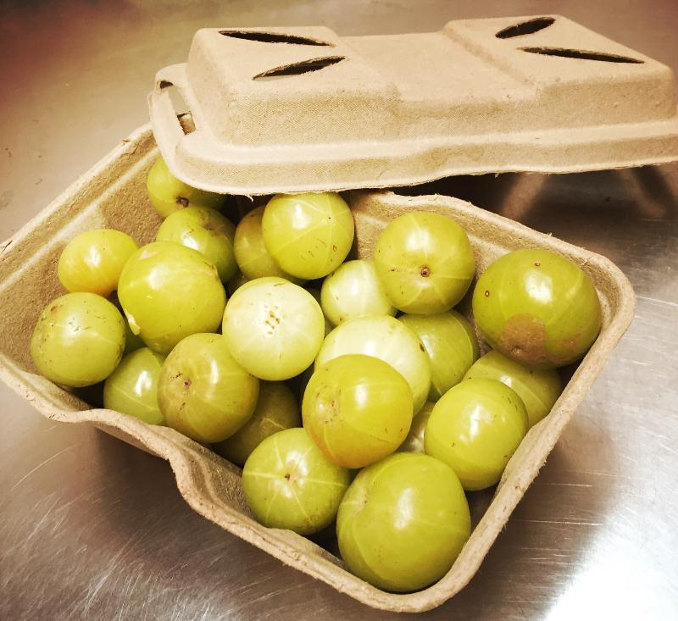
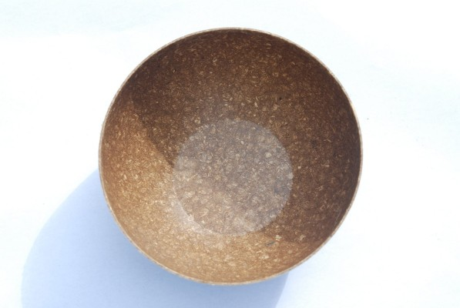
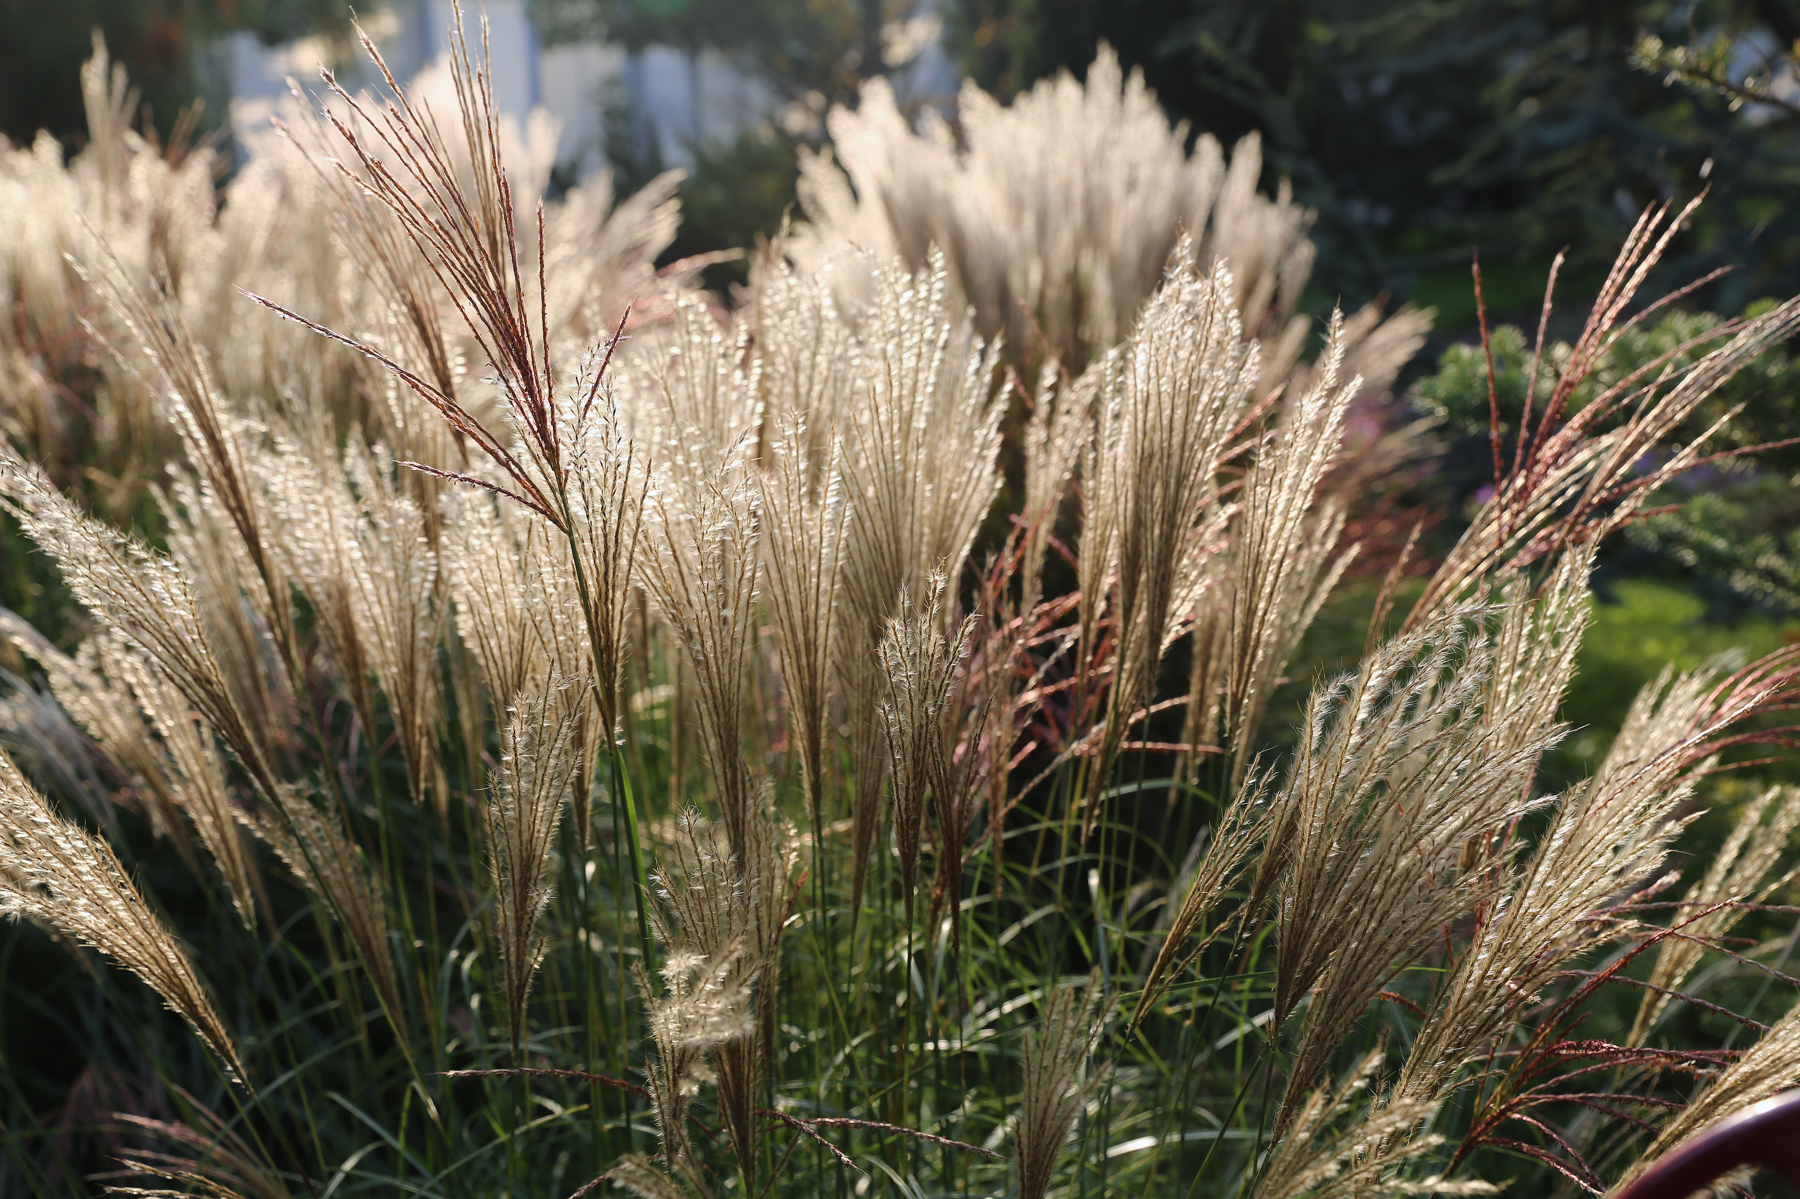
Applications of Green Composites & Fibers
Notes:
http://www.livingasean.com/home-improvement/material/material_tile_husk_sonite/
https://materia.nl/material/miscanthus-biopolymer/
https://materia.nl/article/fluid-solid-designs/
https://yourstory.com/2017/06/bio-lutions/

Slide 5
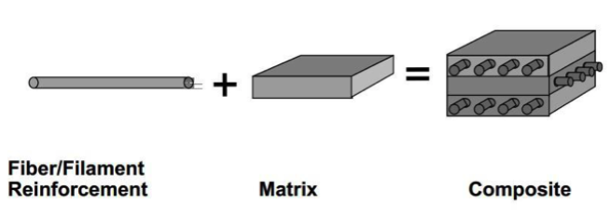
Composite Constituents
Matrix - continuous phase.
Made of biopolymers or petroleum based polymers.
Interface – in between region
Responsible of good matrix/fiber interaction.
Improvement of wettability (often by coupling agents).
Fiber reinforcement
Enhances matrix mechanical properties.
Figure 1. Composite elements (Skillman, 2015)

Slide 6
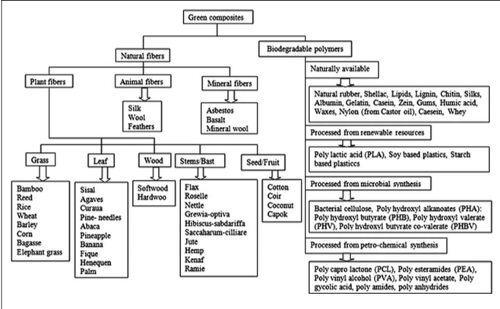
Constituents of Green Composites Fiber & Matrix
Figure 2. Green composite possible components (Bajpai et Al., 2014)
Notes:
Among plant cells talk about cellulose, hemicellulose, lignin, waxes and water soluble compounds

Slide 7
Polylactic Acid (Pros and cons of PLA included) Sustainable Biopolymer
Figure 3 . Sustainability of PLA in a biobased circular economy (Muller et al. 2017)
Notes:
http://www.mdpi.com/1996-1944/10/8/952/htm

Slide 8
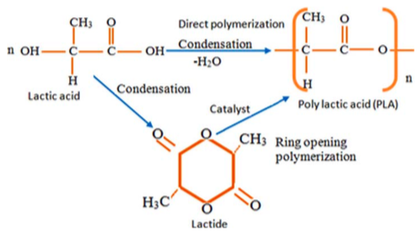
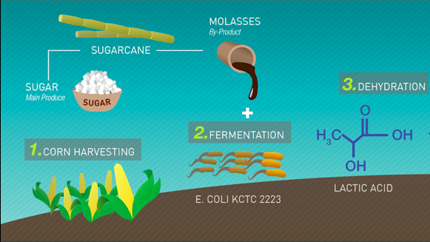
Poly lactic Acid Synthesis and processing
Figure 5. Routes of poly lactic acid polymerization (Bajpai et Al., 2014).
Figure 4. Production of lactic acid from corn starch (MIT-Institute of Design, 2013)

Slide 9
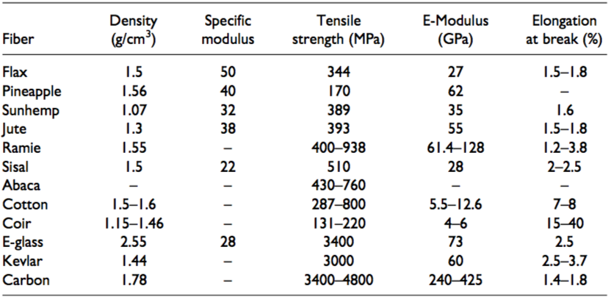
Green Fibers (Pros and cons of green fibers) Mechanical Properties
Elastic/Young’s Modulus
Tensile Strength
Specific Modulus
Elongation at break
Table 2. Mechanical properties of common green and synthetic fibers (Bajpai et Al., 2014)

Slide 10
Types of Composites I Fiber/Matrix Biodegradable Nature
Biodegradability of Composites
Partially biodegradable
(hybrid green composites)
Biodegradable (green composites)
Non-biodegradable
Petroleum-based matrix + fibers
Biopolymer matrix + green fiber reinforcement (or vice versa)
Petroleum-based polymer + green fiber reinforcement

Slide 11
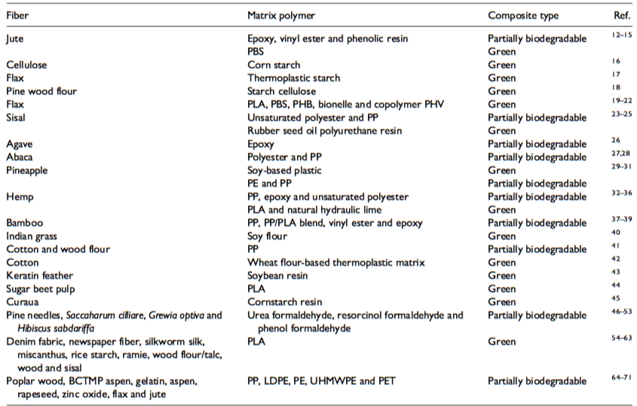
Types of Composites II Fiber/Matrix Biodegradable Nature
Table 1. Partially biodegradable and green composites (Bajpai et Al., 2014)
Notes:
Soy-based plastic can also be replaced by PLA which is a more sustainable biopolymer.

Slide 12
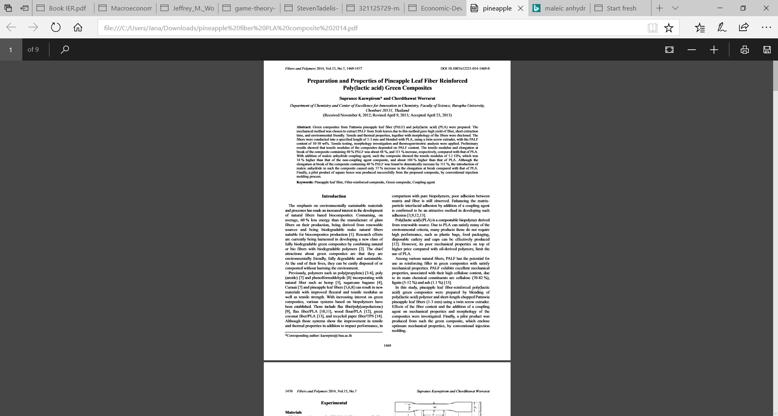
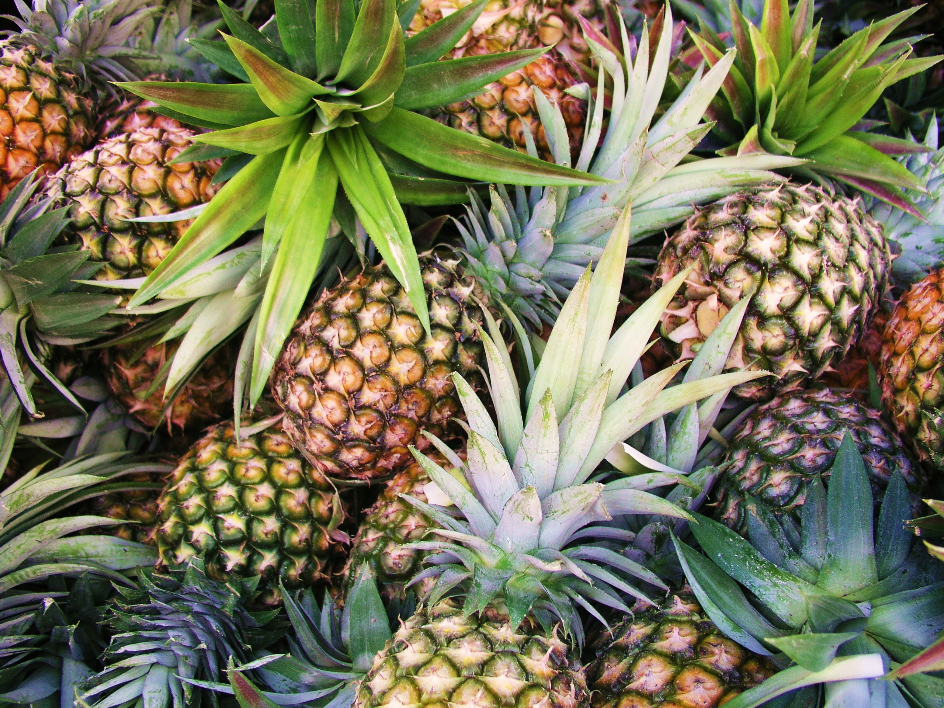
RESEARCH PAPER II
PINEAPPLE LEAF FIBER (PALF) REINFORCED POLYLACTIC ACID (PLA)
A study from Keawpirom & Worrarat (2013) from the Department of Chemistry and Center of Excellence for Innovation in Chemistry, Faculty of Science, Burapha University, Chonburi 20131, Thailand

Slide 13
Research Paper II Preparation and Properties of Pineapple Leaf Fiber Reinforced Poly(lactic acid) Green Composites
A study from Keawpirom & Worrarat (2013) from the Department of Chemistry and Center of Excellence for Innovation in Chemistry, Faculty of Science, Burapha University, Chonburi 20131, Thailand
Preparation of PALF
Preparation of PALF/PLA and PALF/MA/PLA composites
Preparation of Tensile Specimen
Tests
Pilot Product (Preparation & Evaluation)

Slide 14
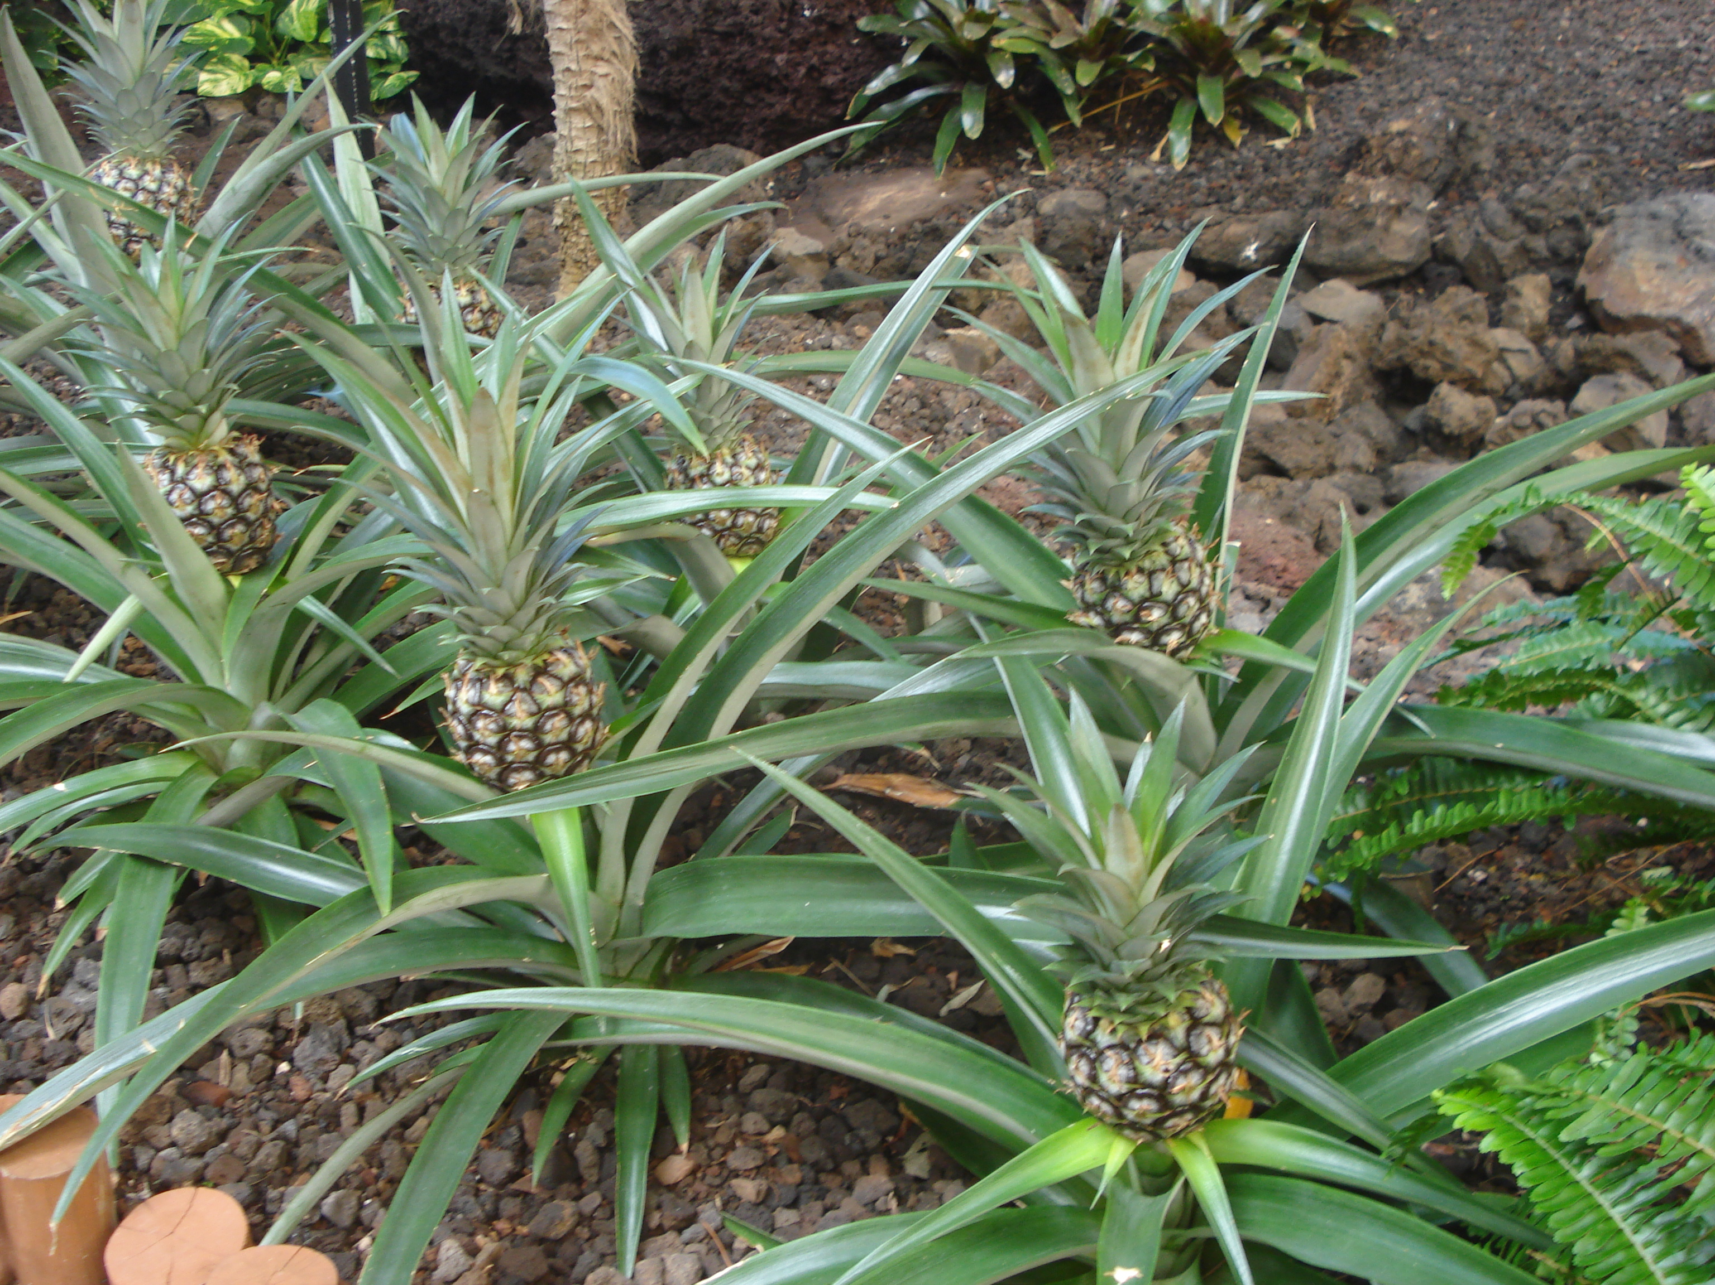
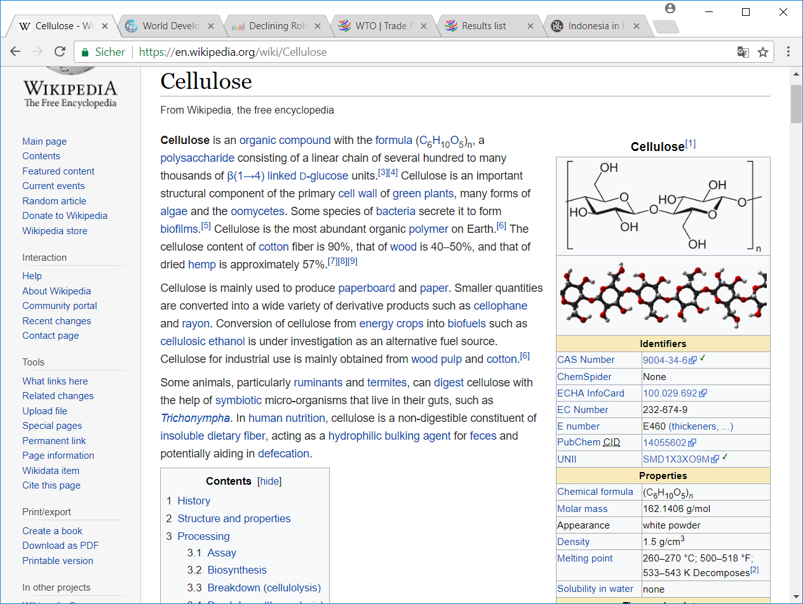
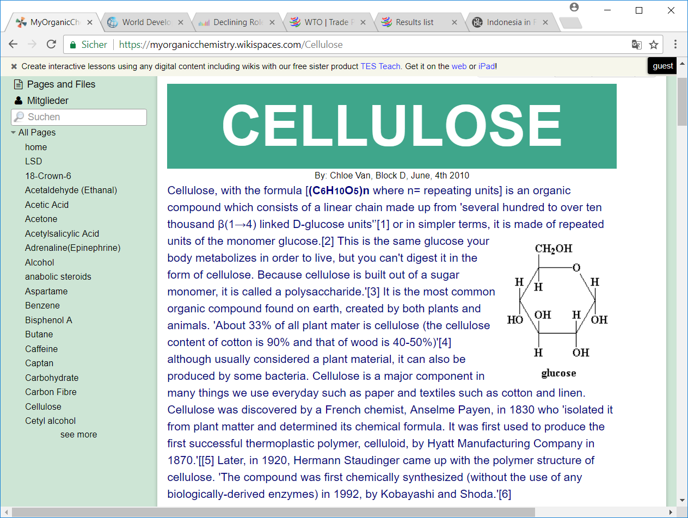
WHAT’S PALF?
CELLULOSE (70-82%) structure alternates: extensive strong, H-binding, linear polymer, micro fibrils, cell wall constructed from cellulose crosslinks, crystal neatly stacked molecules – tight through strong cellulose, bacteria in our gats can degrade it
LIGNIN (5-12%) Hydrophobic, cross-linked phenolic polymers, rigidity, do not rot easily
ASH (1.1%) Non-volatile residue

Slide 15
PALF vs OTHER FIBERS
 | TENSILE STRENGTH (MPa) | YOUNG’S MODULUS (GPa) | ELONGATION AT BREAK (%)
PALF (natural) Paper II | 242 | 10.6 | 2.3
Pineapple (natural) Paper I | 170 | 62 | -
KEVLAR (petroleum-based) | 3000 | 60 | 2.5-3.7
Cotton (natural) | 287-800 | 5.5-12.6 | 7-8

Slide 16
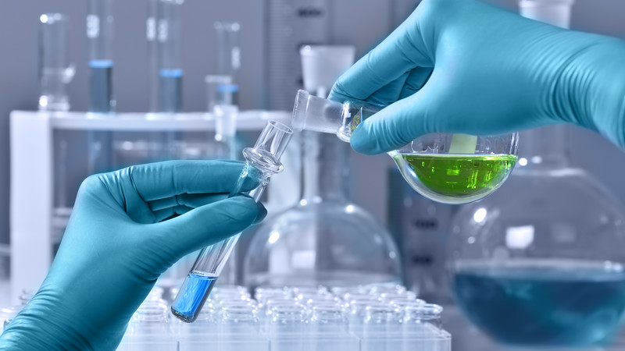
PREPARATION PHASE
PALF
COMPOSITES
PALF/PLA
PALF/MA/PLA
TENSILE SPECIMENS

Slide 17
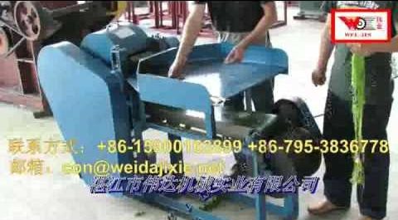
1. PREPARATION OF PALF
Pattawia Pineapple leaves from Rayong (Thailand)
Picking
Clean leaves with water
Freshly extracting fibers:
Extraction machine separates fibers from leaves by mechanic blades
Further processing
Rinse in water
Wash in 2% detergent solution at 70C
Rinse in water again
Dry at room temperature for 2-3h
Hot air oven of 60C overnight
Final steps to dried pineapple leaf fiber of 70-80cm length
Manually chop into short pieces of 1-3mm
Store in moisture prevented bag

Slide 18
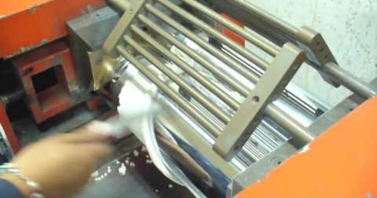
2.1 PREPARATION OF PALF/PLA COMPOSITE
PREP
Dry chopped PALF & PLA under desiccant drier at 80C for 4h
MIX
PLA and PALF (at various fiber cntents: 10, 20, 30, 40 and 50 wt%) in two-roll mill machine (room temperature)
Further processing
Final steps
Mixture into Brabender co-rotating twin-screw extruder (120C at all 6 zones)
Collect strands of extrudate
Pelletizer chops strands into:
Composite pellets
Dry at 80C for 4h
Keep in moisture protectable bag

Slide 19
2.2 PREPARATION OF PALF/MA/PLA COMPOSITE
FIRST
Mix 10 wt% MA with PLA in high speed mixer
MIX
PLA/MA mixture together with chopped PALF in two roll-mill (at 140C rollers surface temperature for 5 mins)
Further processing
Final steps
Mixture into Brabender co-rotating twin-screw extruder (120C at all 6 zones)
Collect the strands of extrudate
Pelletizer chops strands into:
Composite pellets
Dry at 80C for 4h
Keep in moisture protectable bag

Slide 20
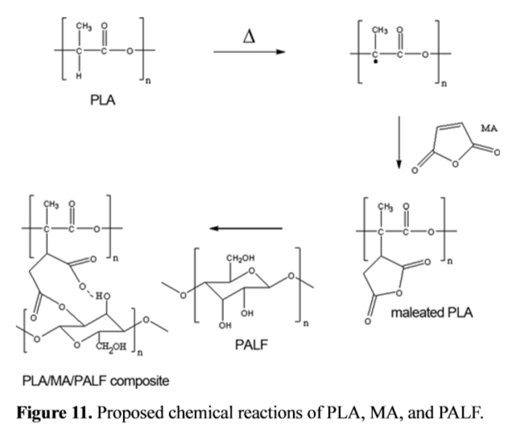
Anhydride carboxyl group (PLA – g – MA)
Hydroxyl group

Slide 21
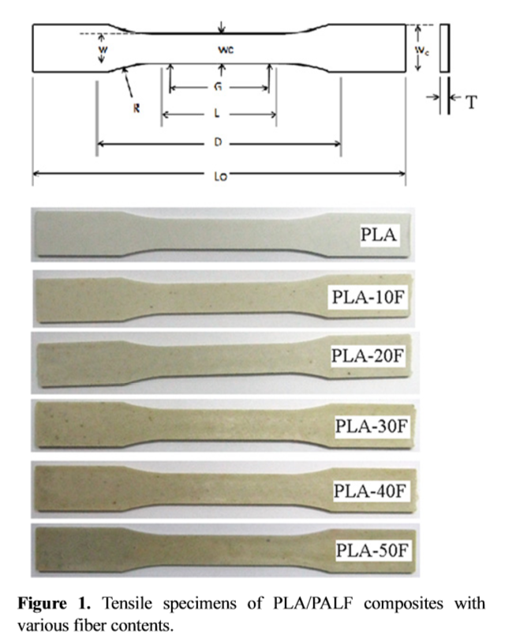
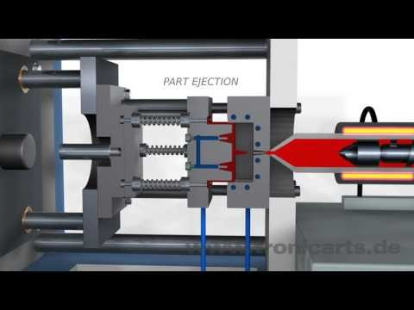
3. PREPARATION OF TENSILE SPECIMEN
PREP
Dry composite pellets in desiccant drier at 80C for 4h
FORM
Injection molding machine (Arburg Allrounder 370U) at 160C in all 4 zones
Mold surface temperature: 50C
cooling time: 25sec

Slide 22
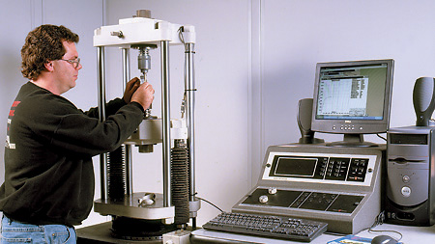
TESTING PHASE
TENSILE
THERMOGRAVIMETRIC
MORPHOLOGY
a. PALF
b. PLA
c. COMPOSITES
PALF/PLA
PALF/MA/PLA

Slide 23
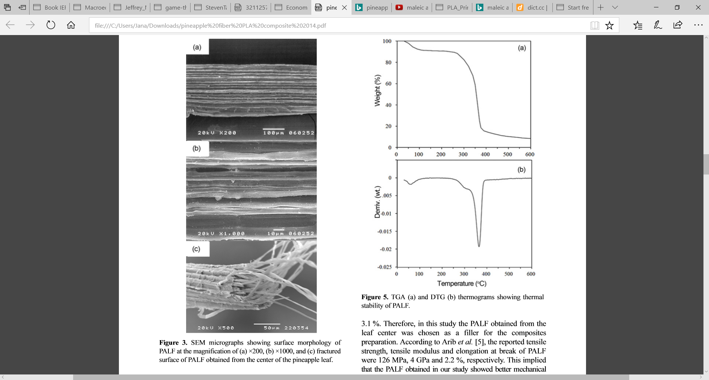
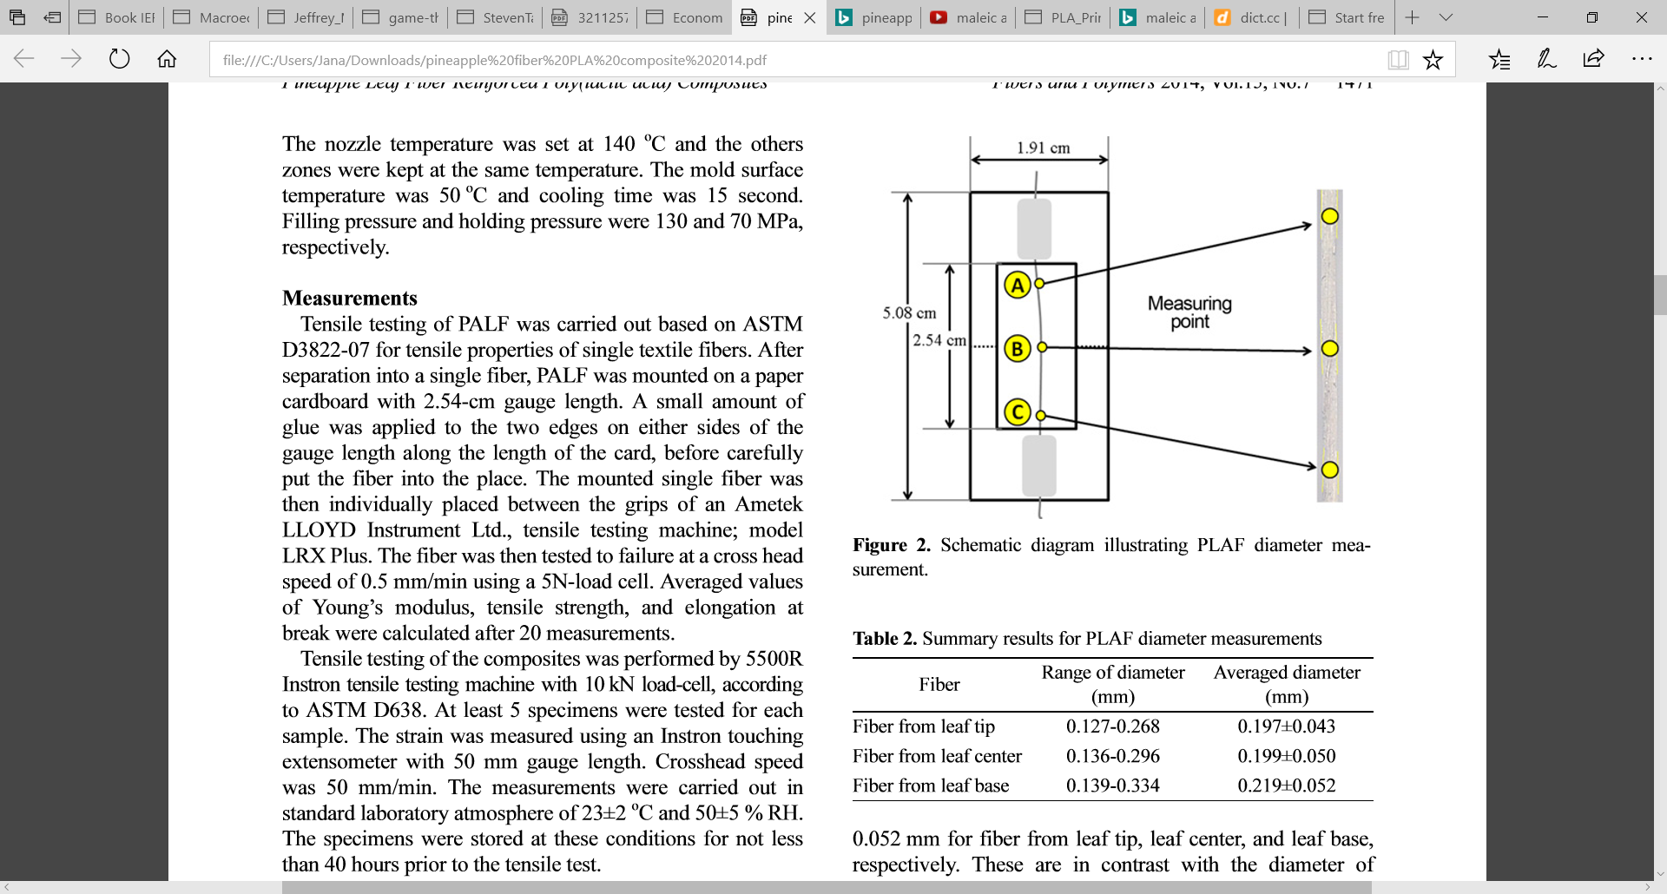
a. INSPECTION OF PALF
Diameter under Microscope X200 magnification:
Wider as compared to 0.02-0.08mm in other literature
⬅ due to fresh extraction, fiber still contain more cellular residues s.a. lignin and hemicellulose (connecting the fibers)
Morphology:
Rough surface
adhersion ability
Assists mechanical interlocking
Improves mechanical properties of composite

Slide 24
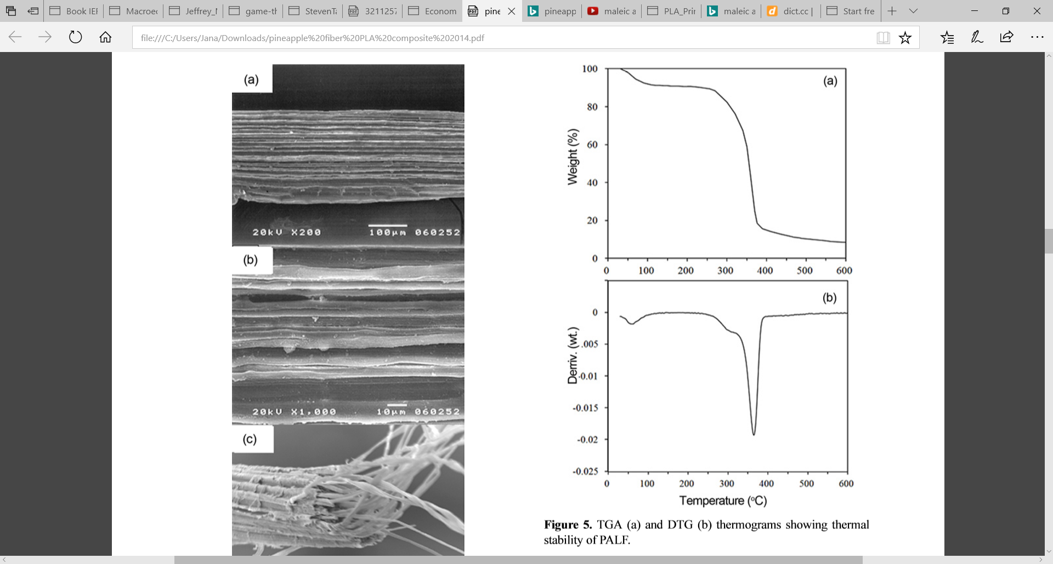
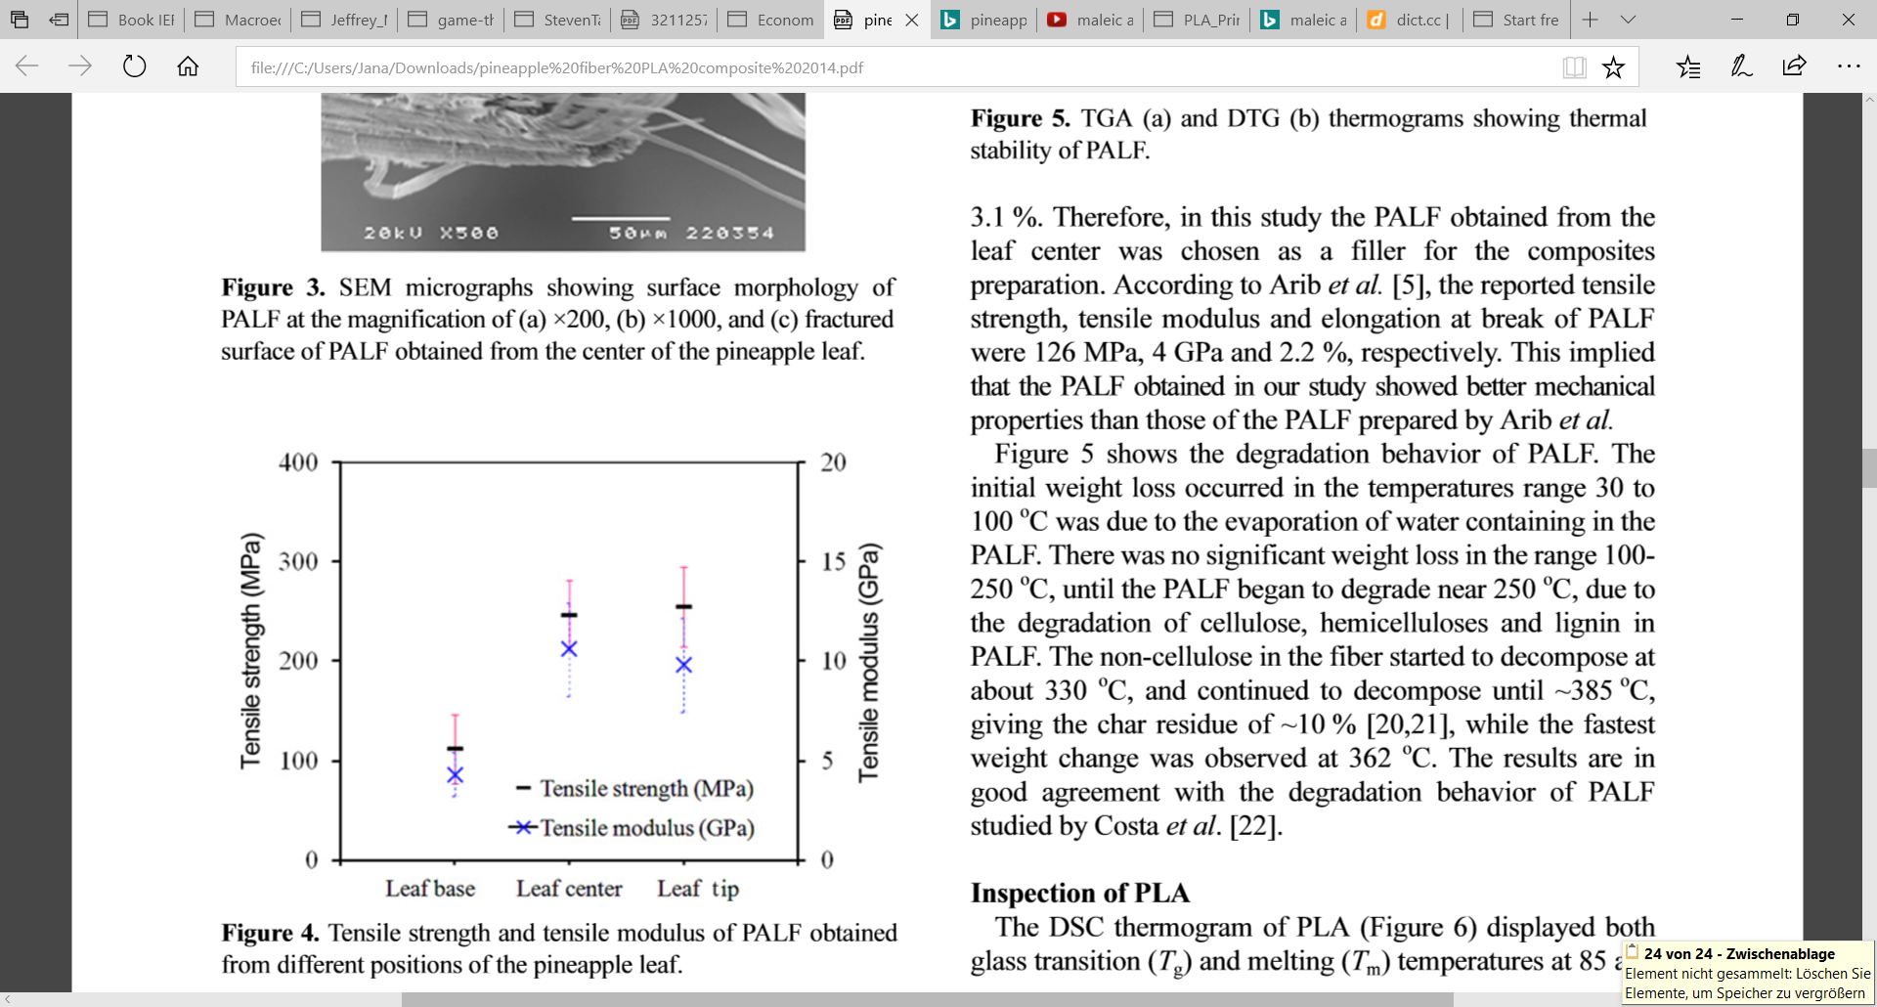
a. INSPECTION OF PALF
Degradation behavior:
Tensile Properties
Vary along the fiber parts Leaf base, center and tip
water loss
Cellulose, hemicellulose, lignin degrade
Char residue ~ 10%
Non- cellulose part degrades
Best performer: Leaf center → used for study

Slide 25
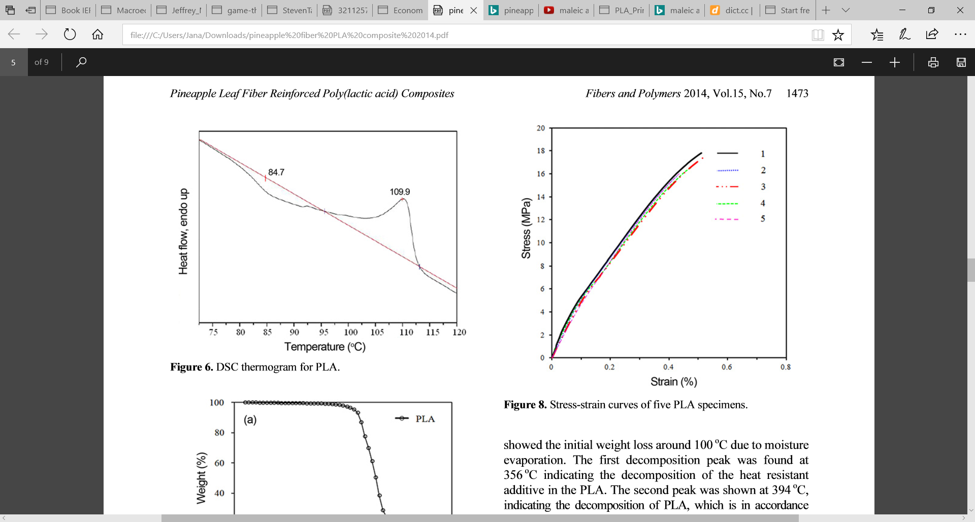
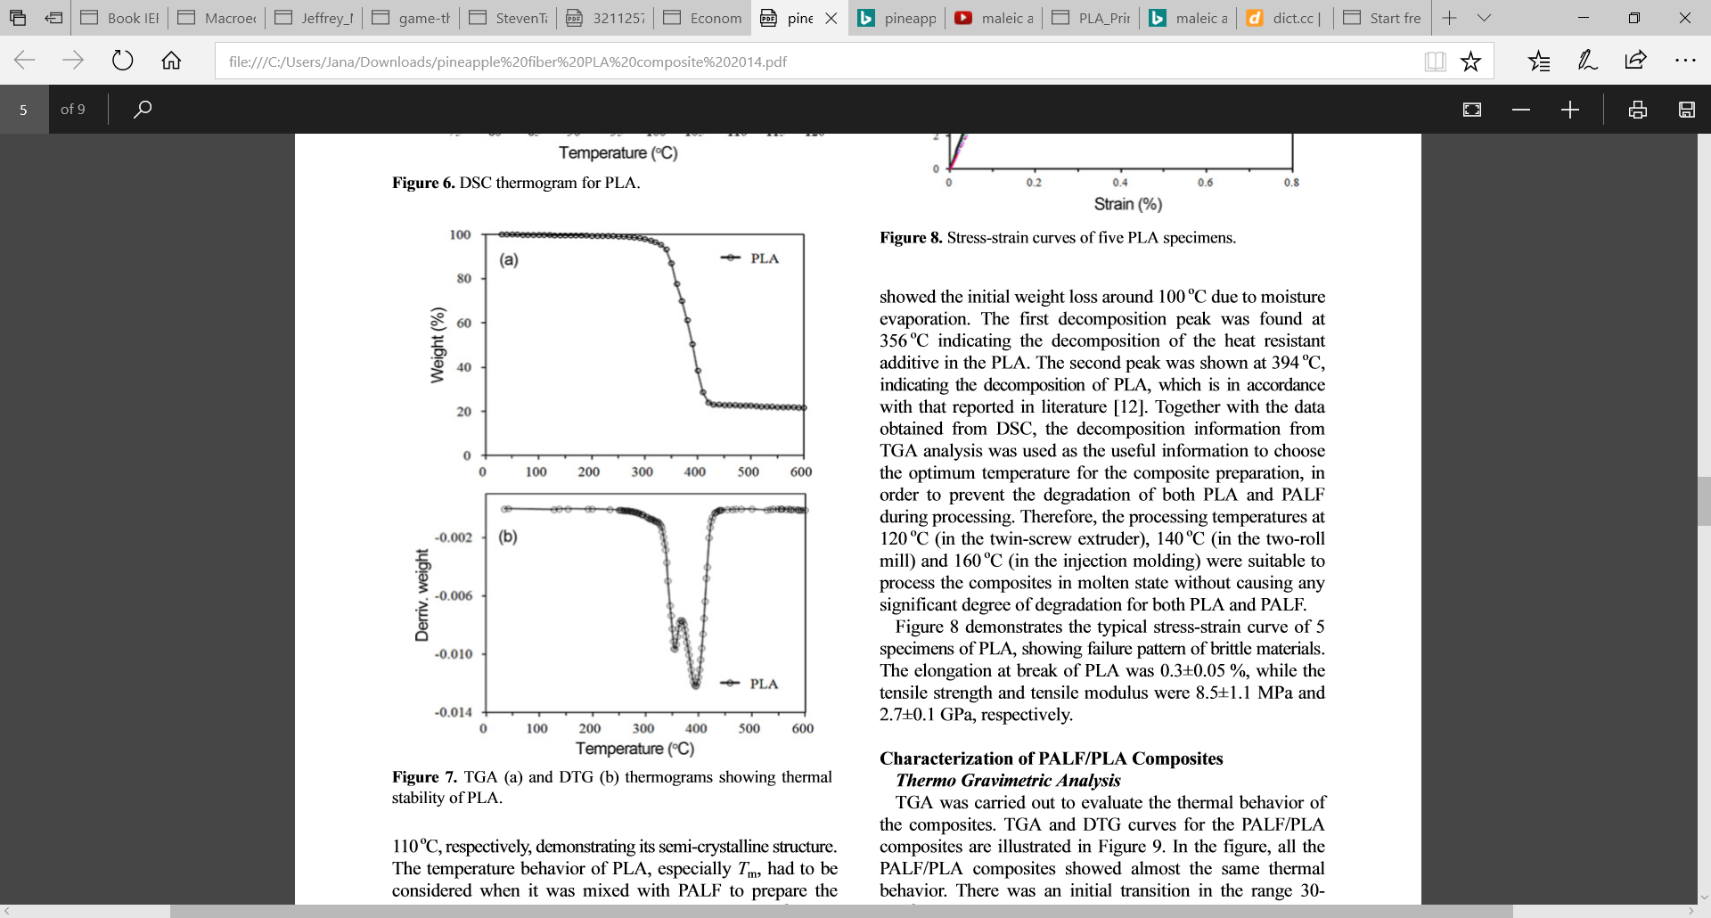
b. INSPECTION OF PLA
Tg
Tm
285C
-> semi-crystalline structure
Hard plastic: used below glass transition temperature
120C used for as mixing temperature
Young Modulus: 2.7+/-0.1 GPa
Tensile strength: 8.5+/-1.1 MPa
Elongation at break: 0.3+-0.05%
Brittle-hard plastic material doesn’t neck
PEAKS
Decomposition of heat resistant additive in PLA
Decomposition of PLA

Slide 26
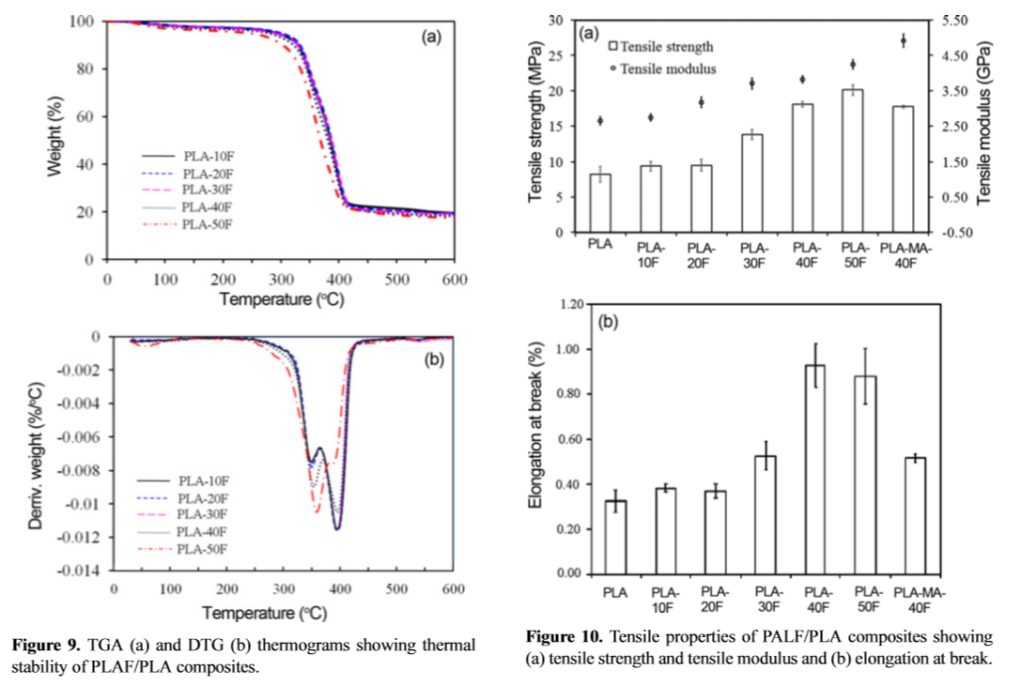
c. CHARACTERIZATION OF COMPOSITES
1) Thermo and Tensile Tests
Not much variation among the composites of different PALF content
variation among the composites of different PALF content
Peaks
Degradation of PALF’s cellulose, hemicellulose & lignin
Depolymerization of PLA matrix
Choosing PLA-MA-40F over PLA-40F: because (intext: improvement of tensile strength and modulus (by 34%) BUT elongation at break decreased by (40%)
Higher PALF content → lower char residue

Slide 27
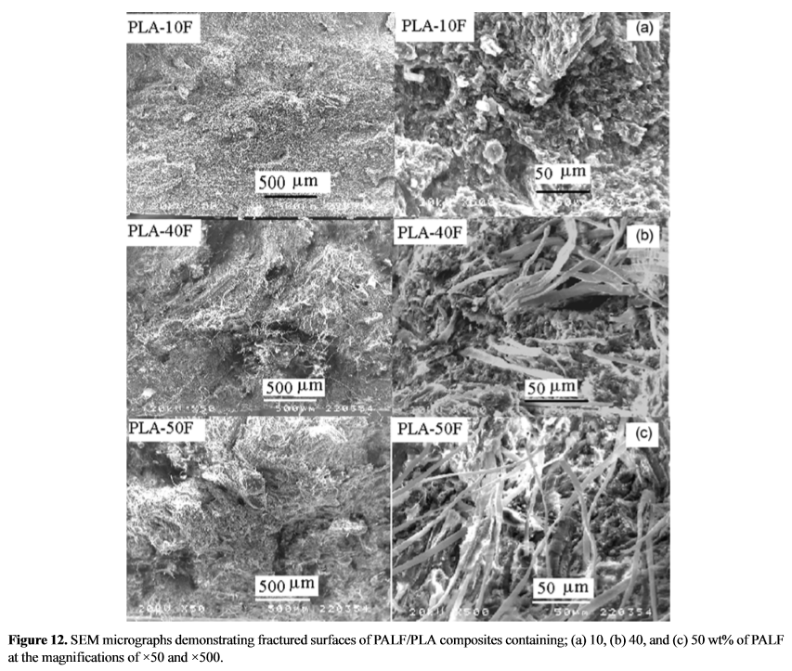
c. CHARACTERIZATION OF COMPOSITES 2) Surface Morphology- choosing 40F over 50F
Choosing PLA-40F over 50F:
difficult to process
elongation at break decreased due to undesired aggregation of fibers
longer milling time and high energy consumption

Slide 28
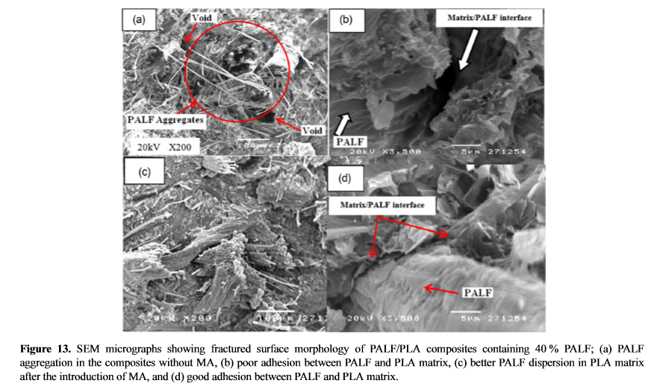
c. CHARACTERIZATION OF COMPOSITES 2) Surface Morphology- choosing to add coupling agent (MA)
Tensile property changes were due to branching and crosslinking
by reaction of anhydride carboxyl group (PLA-__-MA) with hydroxyl group (PALF)
Improved interfacial adhesion between the matrix and the fibers
→ stability of material

Slide 29

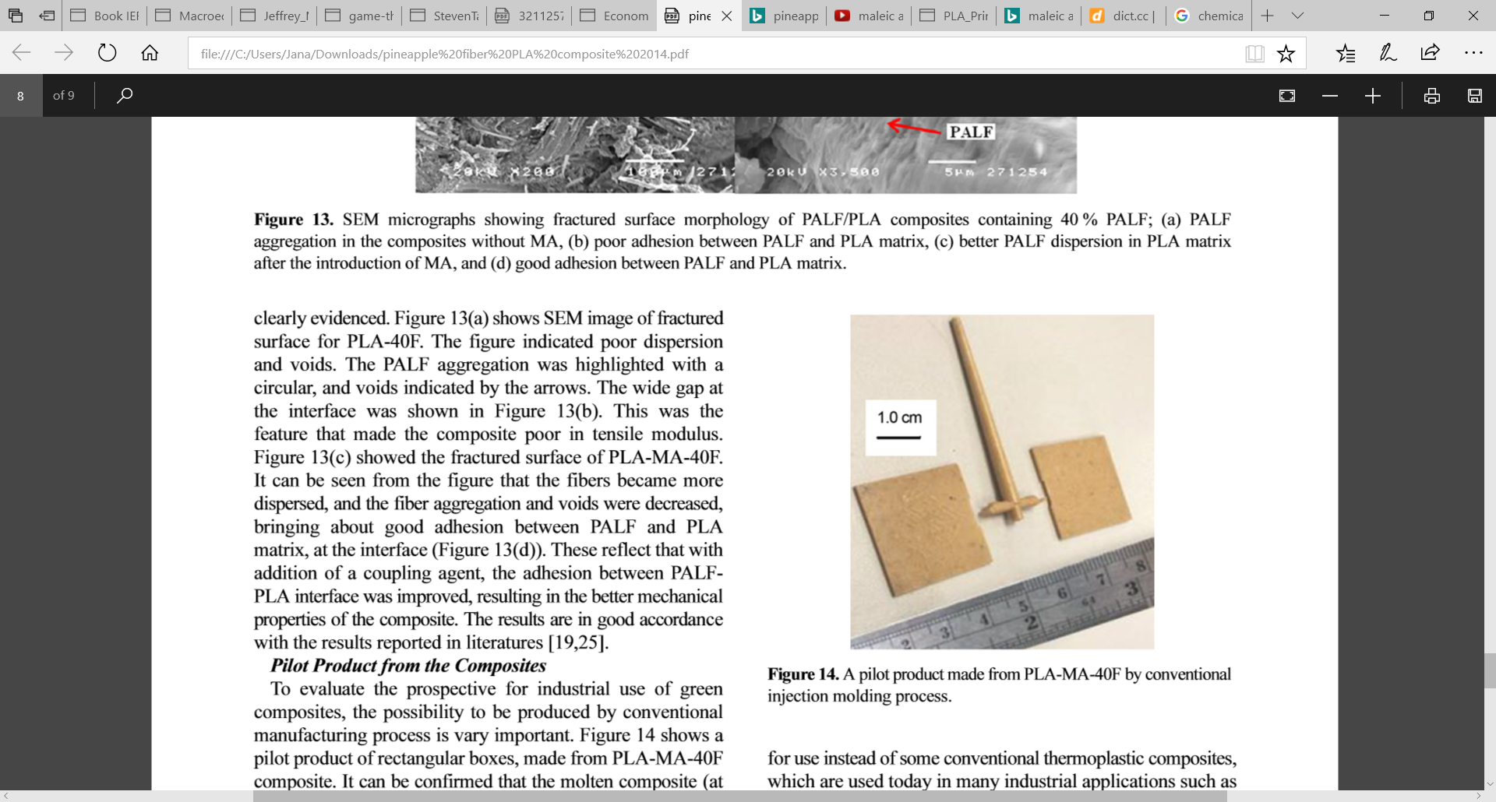
PILOT PRODUCT
PROCESSABILITY OF PROPOSED COMPOSITE (PLA-MA-PALF)
THROUGH CONVENTIONAL MANUFACTURING/INJECTION MOLDING PROCESS
140C | 15sec COOLING
MECHANICAL PROPERTIES OF COMPOSITE GOOD ENOUGH TO REPLACE CONVENTIONAL THERMOPLASTICS
IN INDUSTRIAL APPLICATIONS
CARSEATS, AUTOMOTIVE PANELS, CONSTRUCTION MATERIALS

Slide 30
How can PALF and other green composite fibers be improved? Different Factors affecting Mechanical Properties
% of fiber content
Interaction between fiber and matrix
Fiber aspect ratio
Fiber surface modification
Addition of coupling agents
Fiber orientation
Wettability of fibers
Notes:
Differences in tensile, flexural and impact properties of PLA composites.
Reference 103 – effect of coupling agent.
Reference 105 – effect of surface treatment.

Slide 31
PLA Green Composites Mechanical Properties Presented in the Bajpai et Al. Paper
Flexural
Tensile
Impact Strength
Compressive
Notes:
Impact strength is the capability of the material to withstand a suddenly applied load and is expressed in terms of energy. Often measured with the Izod impact strength test or Charpy impact test, both of which measure the impact energy required to fracture a sample.

Slide 32
PLA Green Composites (Not necessary) Tensile Properties
Tensile Strength (MPa)
Stress a material can withstand before deforming permanently
Young’s Modulus (GPa)
Resistance to being deformed elastically when stress is applied
Elongation at break (%)
Material’s resistance to shape changes without crack formation:
$\frac{Changed length}{Initial length}$ * 100
Material’s resistance to shape changes without crack formation:
(𝐶ℎ𝑎𝑛𝑔𝑒𝑑 𝑙𝑒𝑛𝑔𝑡ℎ)/(𝐼𝑛𝑖𝑡𝑖𝑎𝑙 𝑙𝑒𝑛𝑔𝑡ℎ) * 100
Notes:
Tensile properties can be increased by: Improving matrix properties, Reducing stress concentration & Proper fiber orientation.

Slide 33
PLA Green Composites Variation in Tensile Properties: Fiber Treatment
Table 3. Tensile properties variations of different PLA/Spruce Wood Flour composites (Bajpai et Al., 2014 .)
PLA/Untreated 40% SWF
Remarks
Hydrothermal treatment & use of coupling agents
Increase Young’s modulus
Decrease tensile strength & elongation at break.
Increase tensile strength.
Higher elongation at break & tensile strength.
Surface treatment improved interfacial adhesion between matrix and fiber.
Sample | Tensile Strength (MPa) | Young’s Modulus (GPa) | Elongation at break (%)
PLA | 47.0 ± 4.3 | 3 ± 0.25 | 2.0 ± 0.1
PLA/ Untreated SWF | 37.2 ± 2.0 | 3.73 ± 0.25 | 1.1 ± 0.2
PLA/SWT-SI | 48.0 ± 4.7 | 3.51 ± 0.18 | 1.3 ± 0.2
PLA/Spruce Wood Flour (SWF)
PLA/Spruce Wood Flour (SWF)
Notes:
Improvement of mechanical properties due to surface treatment and addition of coupling agents.

Slide 34
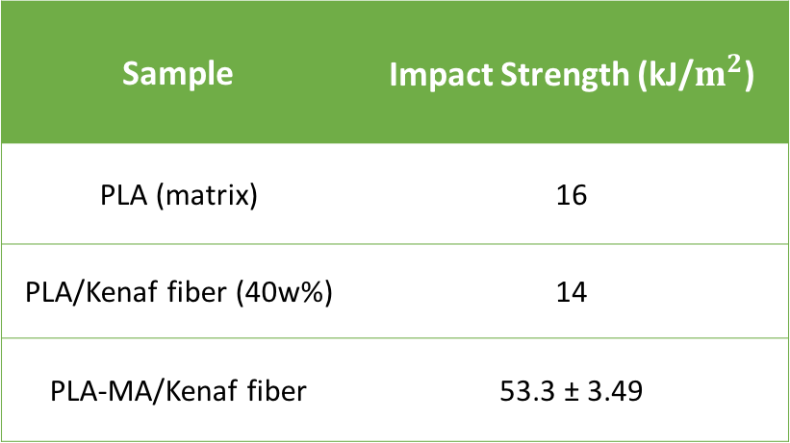
PLA Green Composites Variation in Impact Strength Properties
PLA-MA/Kenaf fiber
PLA/Kenaf fiber (40w%)
Surface treatments or the addition of coupling agents favorably increases impact strength.
Remarks
Table 5. Impact strength variations of PLA compared to modified and unmodified green PLA composites (Bajpai et Al., 2014; Thomas et Al., 2012)
Sample | Impact Strength (kJ/$m^{2}$)
PLA (matrix) | 16
PLA/Kenaf fiber (40w%) | 14
PLA-MA/Kenaf fiber | 53.3 ± 3.49
Notes:
https://www.crcpress.com/Natural-Polymers-Biopolymers-Biomaterials-and-Their-Composites-Blends/Thomas-Ninan-Mohan-Francis/p/book/9781926895161

Slide 35
PLA Green Composites Compressive Properties
Compressive Strength (MPa)
Stress a material can withstand against size changes.
Compressive Modulus (GPa)
Material’s resistance to being deformed elastically when stress is applied

Slide 36
PLA Green Composites Variation in Specific Mechanical Properties I
Table 3. Mechanical variations of two different PLA green composites compared to PLA matrix (Bajpai et Al., 2014; UL Prospectors, 2017).
Sample | Compressive Strength (MPa) | Compressive Modulus (GPa) | Tensile Strength (MPa) | Tensile Modulus (GPa) | Flexural Strength (MPa) | Flexural Modulus (GPa)
PLA (Matrix) | - | - | 47.0 ± 4.3 | 3 ± 0.25 | 47 | 2.39
PLA-MA/Kenaf fiber | 345 ± 3.11 | 174 ± 0.11 | 28.3 ± 6.54 | 2.87 ± 0.23 | 46.7 ± 3.83 | 2.05 ± 0.11
PLA-MA/Rice hulls fiber | 216 ± 2.67 | 146 ± 0.07 | 26.7 ± 1.49 | 2.76 ± 0.11 | 28.8 ± 3.14 | 1.63 ± 0.09
Notes:
Tensile Modulus and Strength are equal where as Compressive Modulus and Strength are different from each other.
https://plastics.ulprospector.com/generics/34/c/t/polylactic-acid-pla-properties-processing

Slide 37
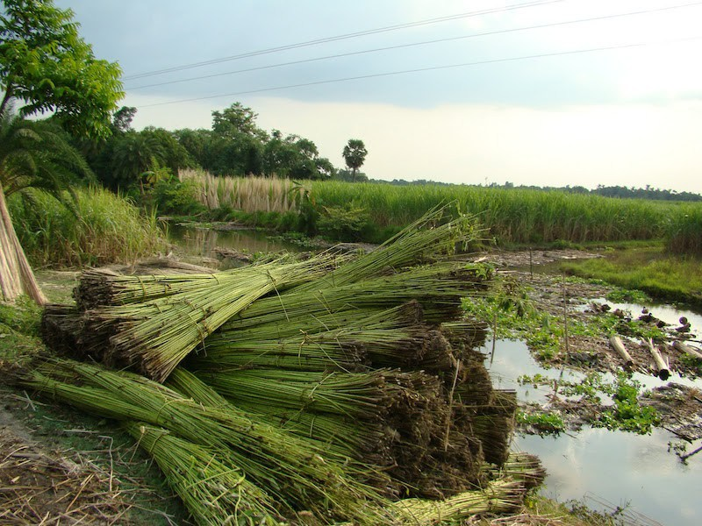
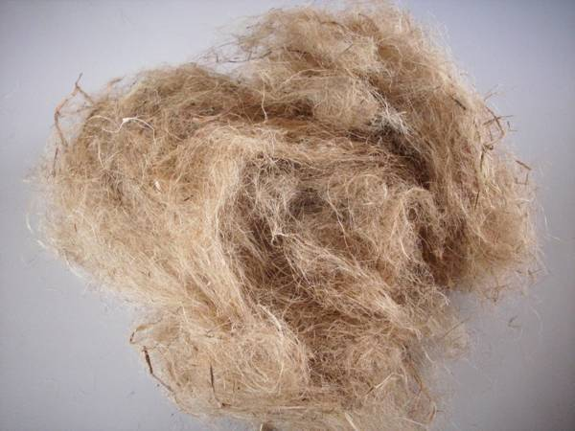
PLA Green Composites Variation in Specific Mechanical Properties II
PLA-MA/Kenaf fiber
PLA-MA/Rice hulls fiber
Different fibers present specific and unique mechanical properties
Remarks
Notes:
Material’s ability to resist deformation over an applied load.
It is not an intrinsic property of a material, it is dependent on the tensile, compressive and shear properties of a material. When a flexural loading is applied to a specimen, all three of the material’s basic stress states are induced. Material failure, then, is dictated by which of the three basic stresses is the first to reach its limiting value — that is, its strength.

Slide 38
DISCUSSION
Critical reflection on PALF paper
What’s left unclear
Linguistic and grammar mistakes
what could the heat resistant additive be in PLA
Statement: ‘impact strength and modulus improved with MA’ (not visible in table)
Does not seem to be a neutral evaluation because it seems the composite they produce is the best version of it and that all the outcomes have positive impact on characteristics of palf/composite – why do we use ma if the only thing that is improving is the tensile modulus while tensile strength even slightly deceases or at least stays constant and why did the decrease in elongation at break matter when choosing 40 over 50 wt% of palf but did not matter when choosing to add the MA??
Addition of MA: biodegradable?
Palf paper is missing mechanical tests (flexural and impact strength, compressive strength
Pilot product has not been tested
2. General reflection on palf, pla, natural fibers and green composites
Lca of PALF
Pros and cons of PLA (brittle>)
Pros and cons of natural fibers
Swot of green composites
3. Applicability, Economic Aspects and role in transition to BBE

Slide 39
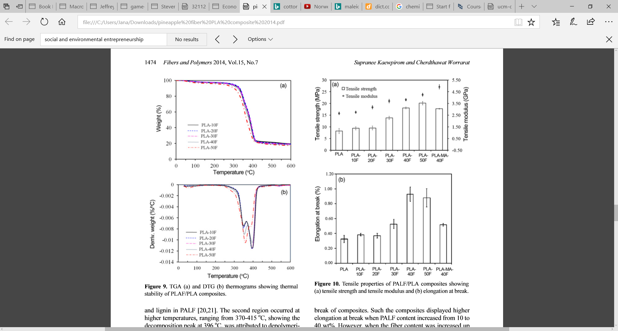
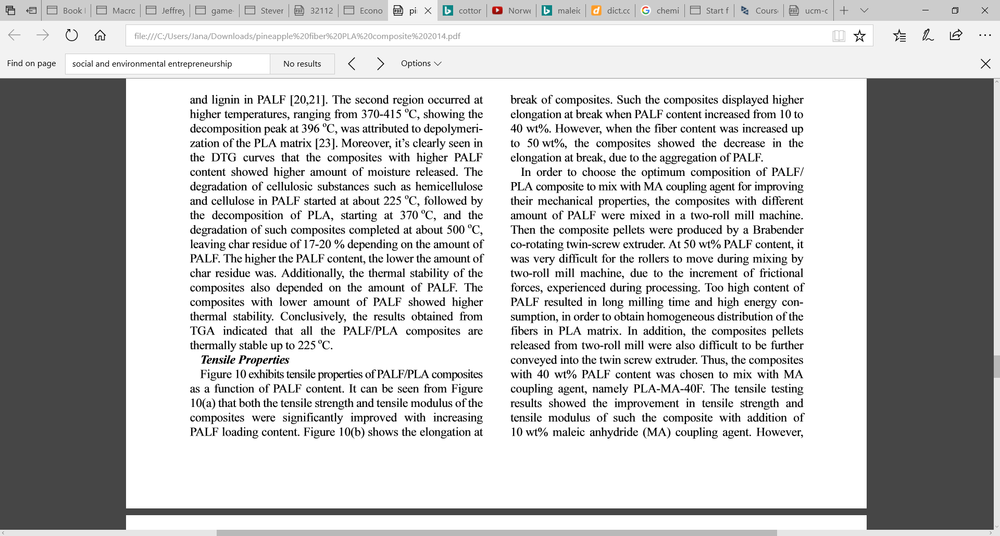
1. Critical reflection on PALF paper
What’s left unclear
Low quality of linguistic and grammar
What could the heat resistant additive in PLA be?
Statement: ‘impact strength and modulus improved with MA’ (not visible in table!)
Lacking neutrality of evaluation
Paper does not seem to portray a neutral evaluation: it seems the composite they produce is the best version of it and that all the outcomes have positive impact on characteristics of palf/composite – why do we use MA if the only thing that is improving is the tensile modulus while tensile strength even slightly deceases or at least stays constant and why did the decrease in elongation at break matter when choosing 40 over 50 wt% of palf but did not matter when choosing to add the MA??
Test results differ from findings of other studies (comparability?!)
Palf paper is missing mechanical tests (flexural and impact strength, compressive strength
Pilot product has not been tested
Addition of MA: biodegradable?
PLA might incorporates food competition
→ problematic for large scale production

Slide 40
3. Applicability, Economic Aspects and Role in transition to BBE
3.1 Economic Perspective – Applicability
PALF (expensive fashion brand, traditional cloths in__)
Opportunities
simple extraction, no food competition
relatively cheap, simple extraction
source already given by pineapple plantages
needs same infrastructure as common plastics/fibers
High value products: Exclusivity/statement clothing/etc can be addressed → potential for green premium
Otherwise: Low price/quality food packaging potential
Problems
only regionally available → transportation costs remain
transition to bio/carbon-neutral process is costly/takes long
nutritional value to soil?,
Product quality might not be competitive with petroleum-derived fibers (measurements/performance comparison next slide)
Price of MA (seems to be necessary?)

Slide 41
PALF Applications – Textile market
Niche market attracts sustainable consumer and producer – market transformation/creation
Traditional clothing in Phillipines and other nations
High fashion textiles
Sustainable and Competitive
Mass Consumer Product
Creation of high price niche market (extremely high green premium)

Slide 42
Natural Fibers: From Niche to Mass Market
Mass Demand cannot be met without harming the environment (sharp increase in supply costs e.g. transportation, deforestation, etc.)
Niche Market
Mass Demand can be met without harming the environment
Price
Price
Price
Firm A
Firm A & B
Supply
Demand
Green Premium
Supply
Supply
Demand
Demand
Quantity
Quantity
Quantity
Competitiveness drives down/ Consumers are not willing to pay Green Premium
Suggested solution:
local/regional fibers used for local supply

Slide 43
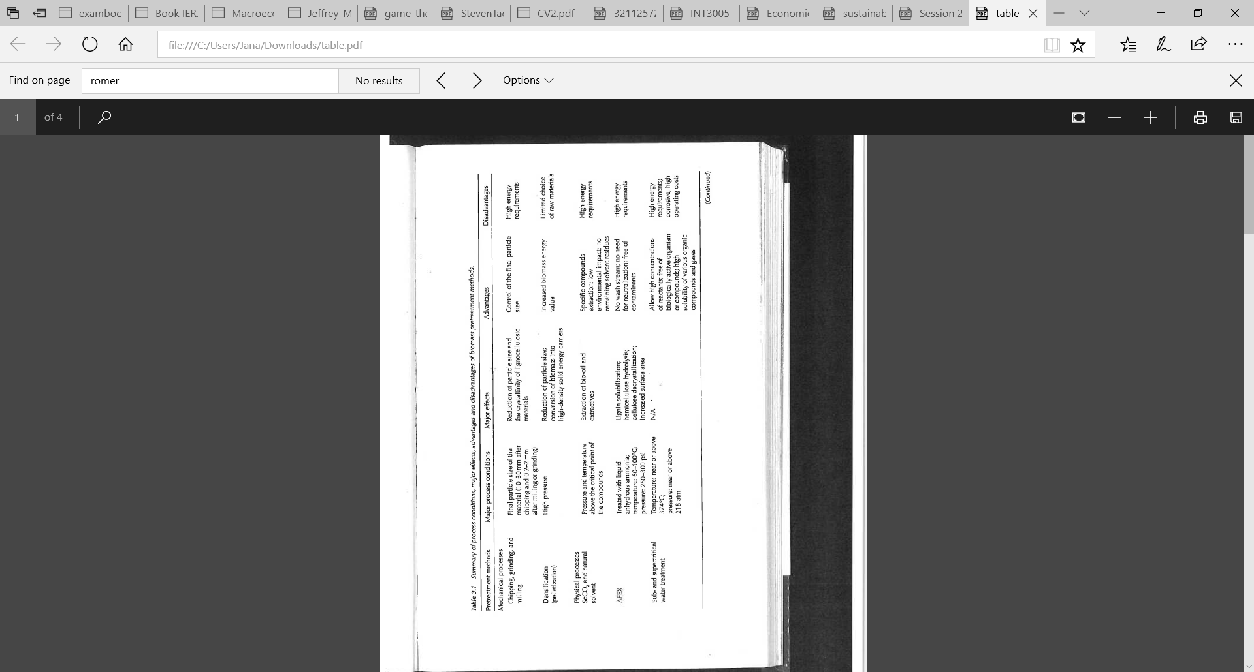
LCA transform Pineapple Leaf into Plastic?
Growing 12-14 months (from pineapple top waste)
Picking
Extracting fibers (machine 10$ energy use: _)
Washing (water use: ___), detergent (use bio-detergent!)
Drying (energy used by hot air oven: __)
Usage of anti-moisture plastic bag
PLA production (corn vs oil)
Two-roll mill machine (energy usage)
Co-rotating twin screw extruder (energy usage)
Pelletizer (“)
Injection molding
Biodegradation: high temperature/

Slide 44
3. Applicability, Economic Aspects and Role in transition to BBE
3.1 Economic Perspective – Market analysis
b. PLA (niche market in expansion process)
Commonly accepted matrix
Some companies operating in PLA market: BASF, Galactic, NatureWorks, Corbion Purac, Pyramid Bioplastics, Danimer Scientific, Dow Chemical, Synbra, Henan Jindan Lactic Acid Technology, Musashino Chemical, Futerro, Teijin and Wei Mon Industry.

Slide 45
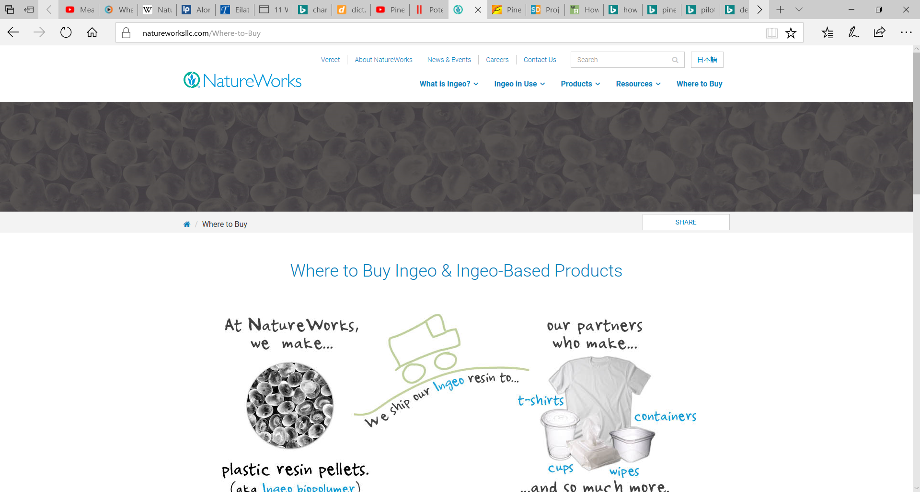
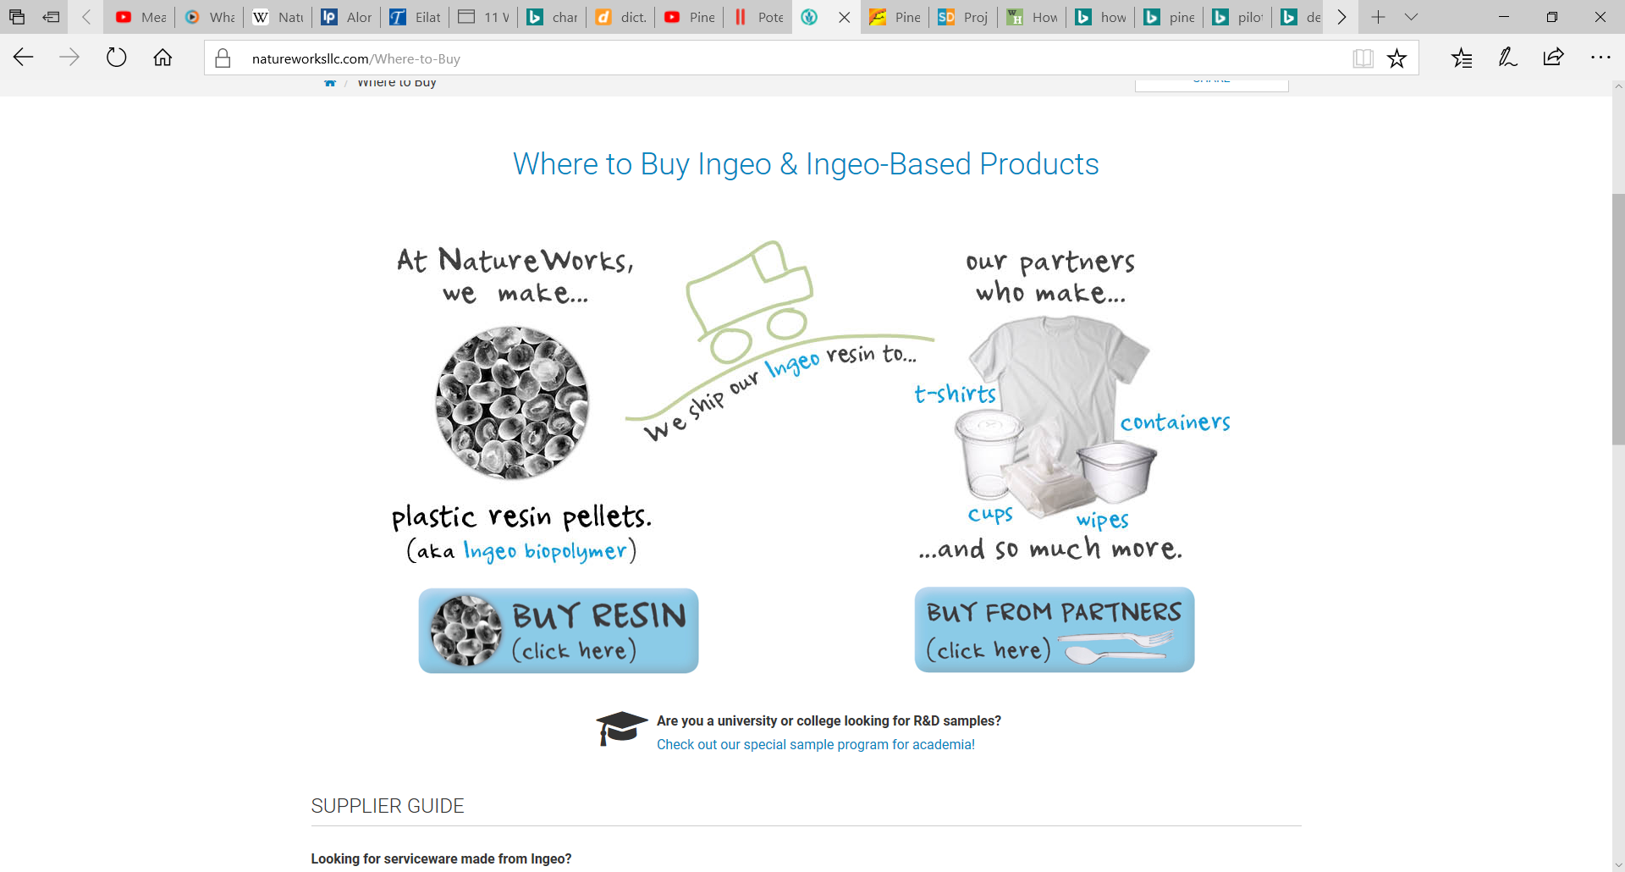
Pla applications/market

Slide 46
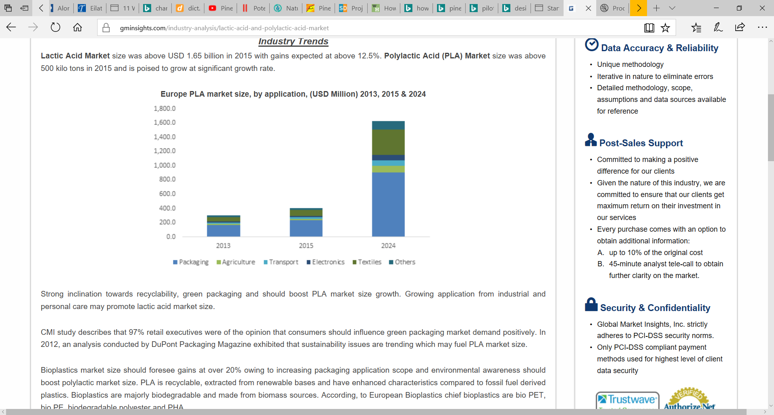
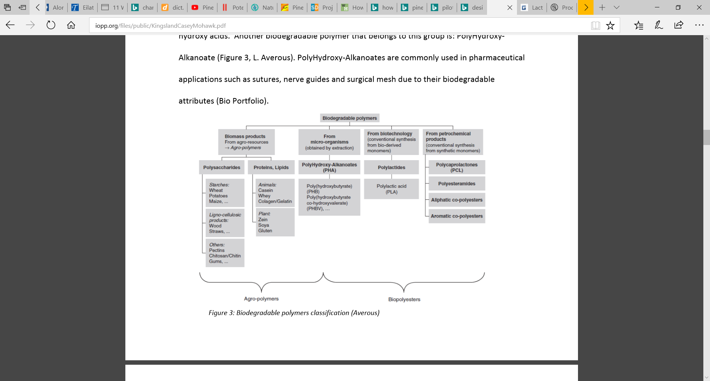
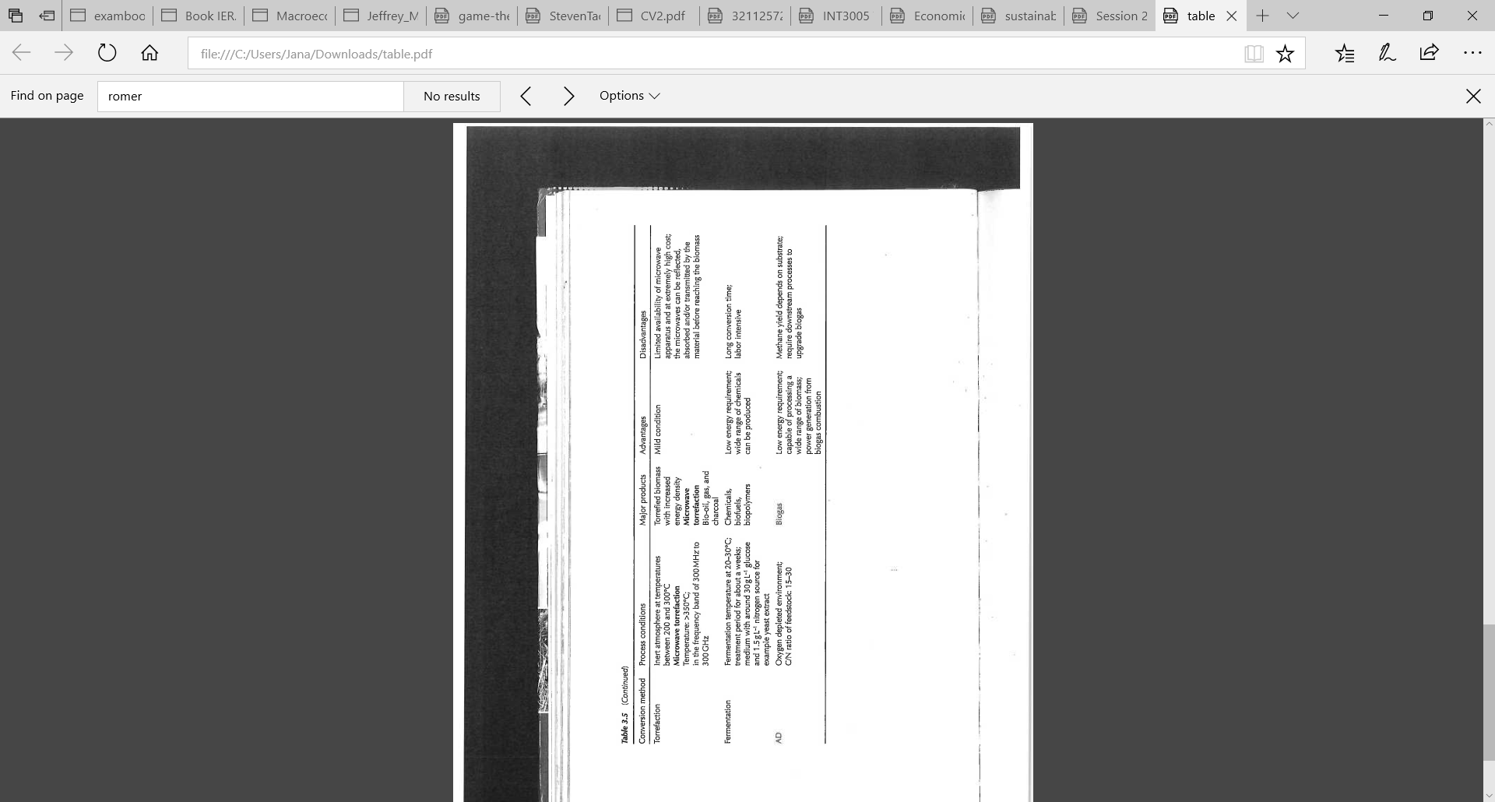
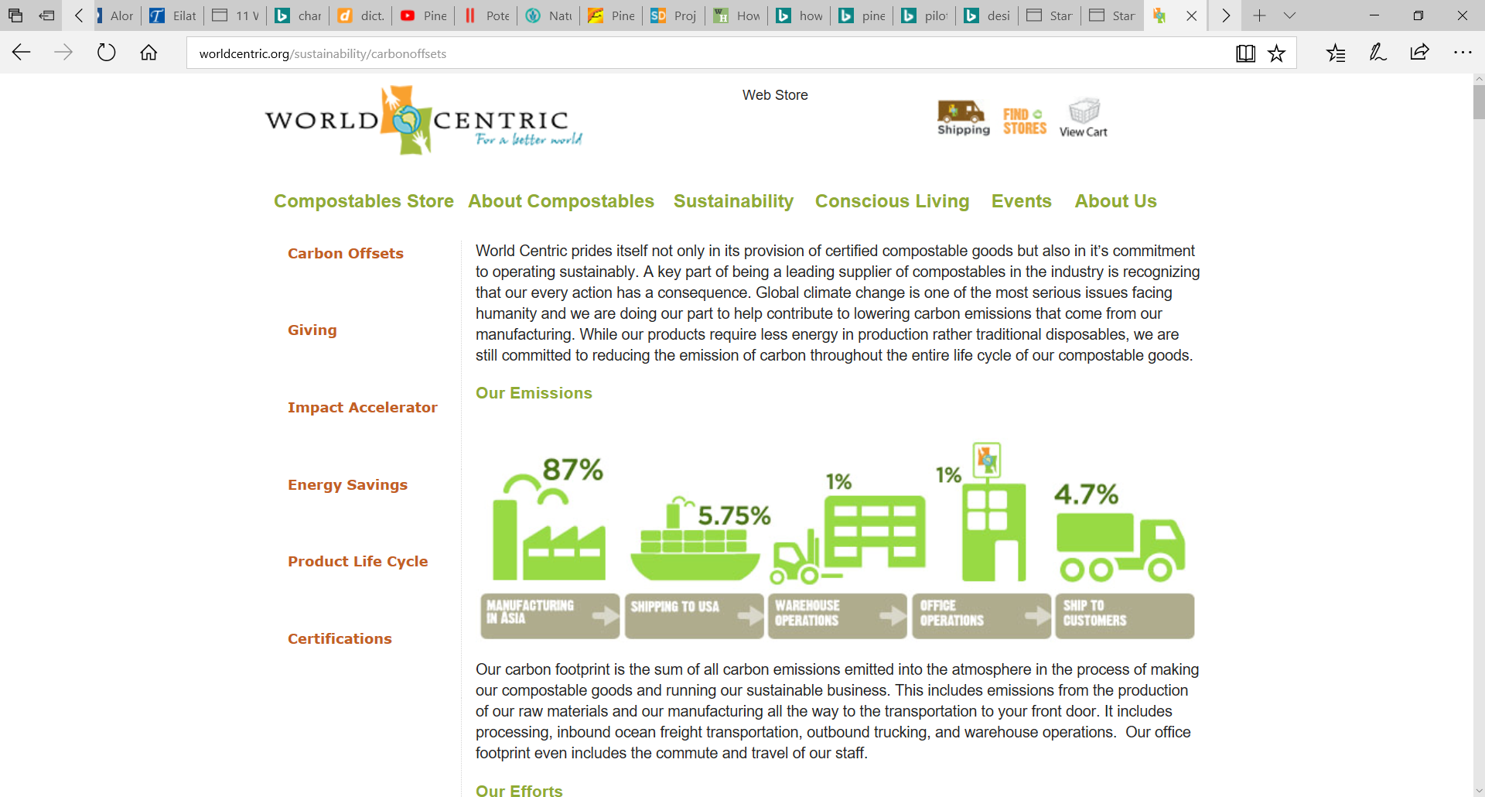
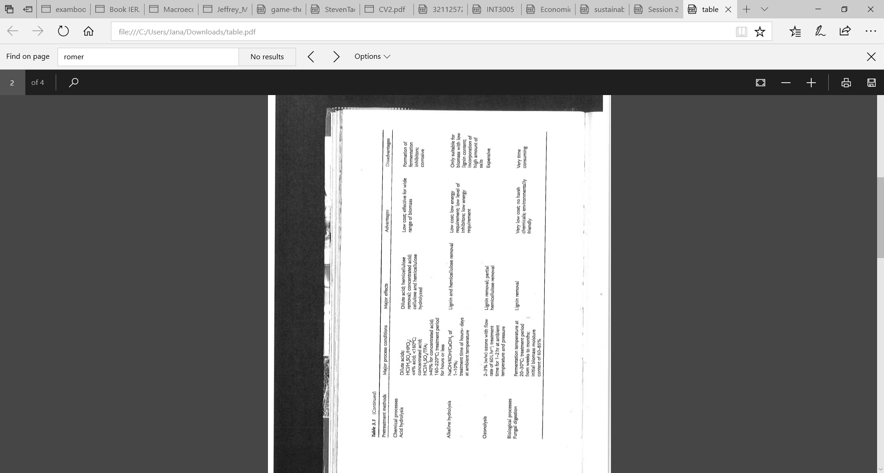
LCA of PLA
http://worldcentric.org/sustainability/manufacturing/PLA

Slide 47
SWOT of fully GREEN COMPOSITES
STRENGTHS Biodegradable Use of bacteria to biodegrade Higher temperature of degradation good for processing and material resistance Composite made from renewable resource Fiber made from agro-waste (= byproducts of existing goods/food) Processability with conventional manufacturing (easy transition) 65% less energy use for PLA 68% lower GHG emissions for PLA | WEAKNESSES High temperature of degradation bad for compostability Not cost-effective yet Transportation cost due to regional differences in availability (as material can only be grown in certain areas)
OPPORTUNITIES Application range from rural to high-tech (popular in textile, construction and automotive) Potential to become cost competitive/effective alternative to petrol-based Enhance rural area (PALF) in South-East-Asia but also Latin America Use local fibers (s.a. chicken feather) to overcome transportation Crude oil index volatile -> attract future oriented/long-term investors | THREATS PLA made from starch (potential for food/feedstock competition) Increased demand might lead to extensive use of land (like deforestation as in Brazil) Potentially exhaustion of soil (nutrients of leaves taken away)

